Slide 2
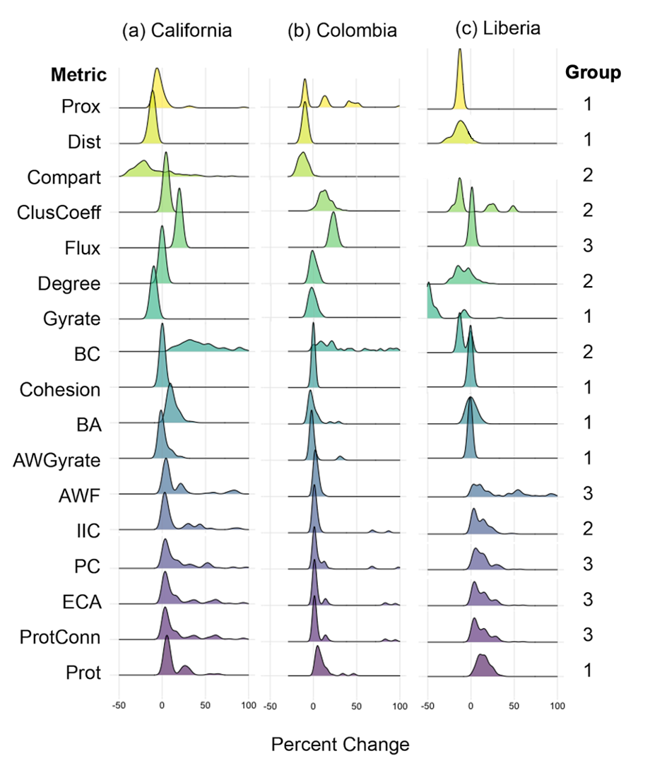

Slide 3
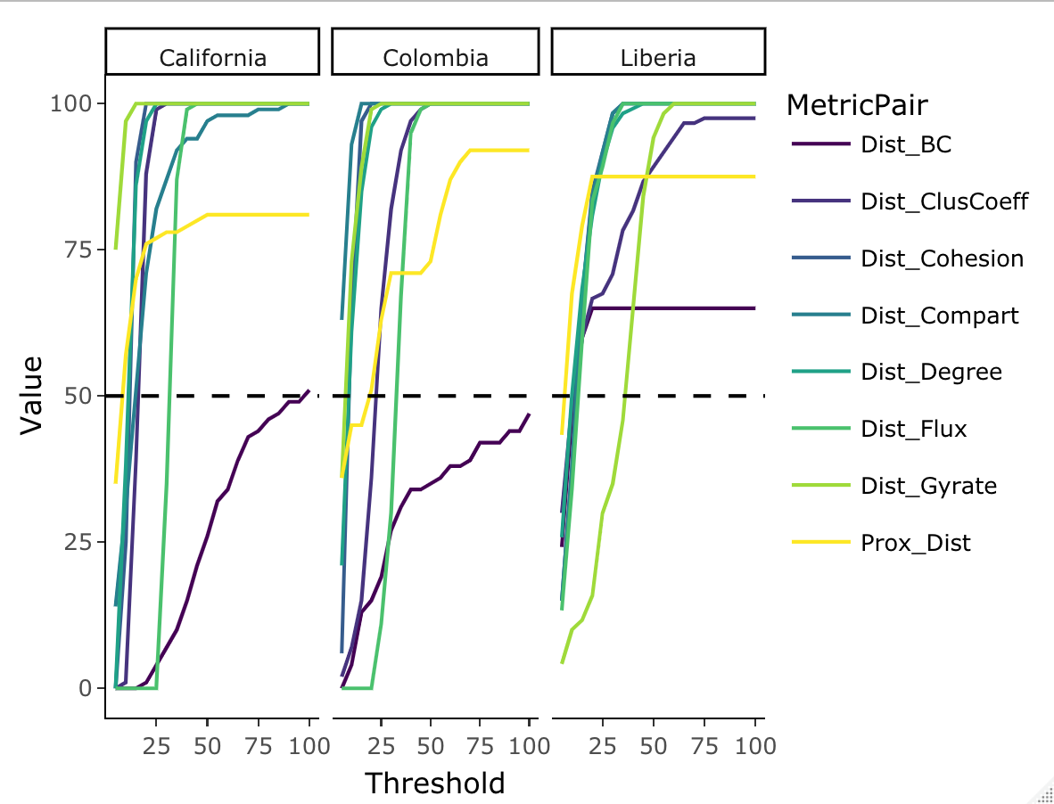
(1) California
(2) Colombia
(3) Liberia
Metric
BC
ClusCoeff
Cohesion
Compart
Degree
Proportion of simulations (%)
Flux
Gyrate
Prox
Absolute difference in percent changes with Dist

Slide 4
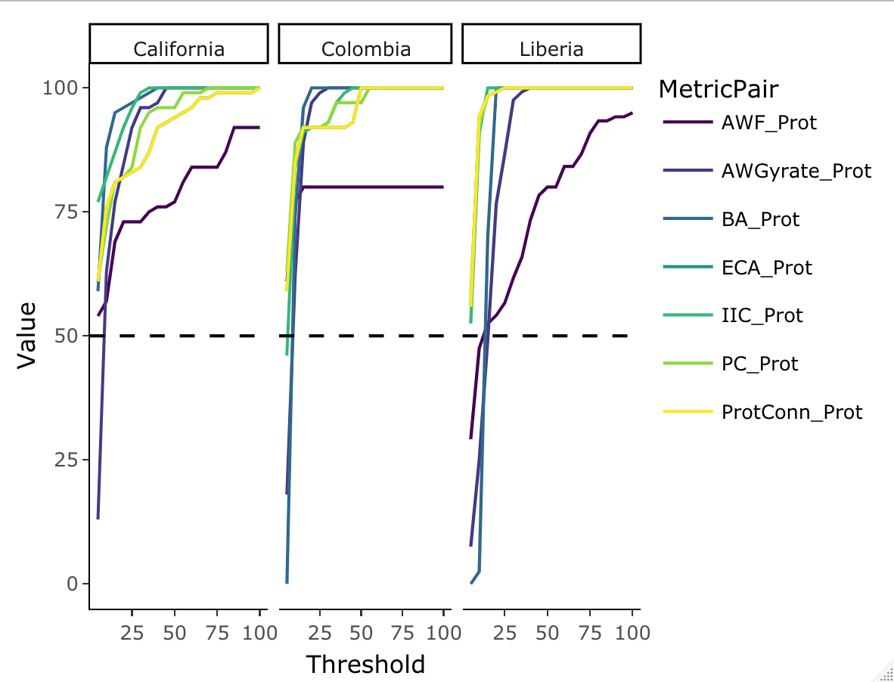
(1) California
(2) Colombia
(3) Liberia
Metric
AWF
AWGyrate
BA
ECA
IIC
Proportion of simulations (%)
PC
ProtConn
Absolute difference in percent changes with Prot

Slide 5
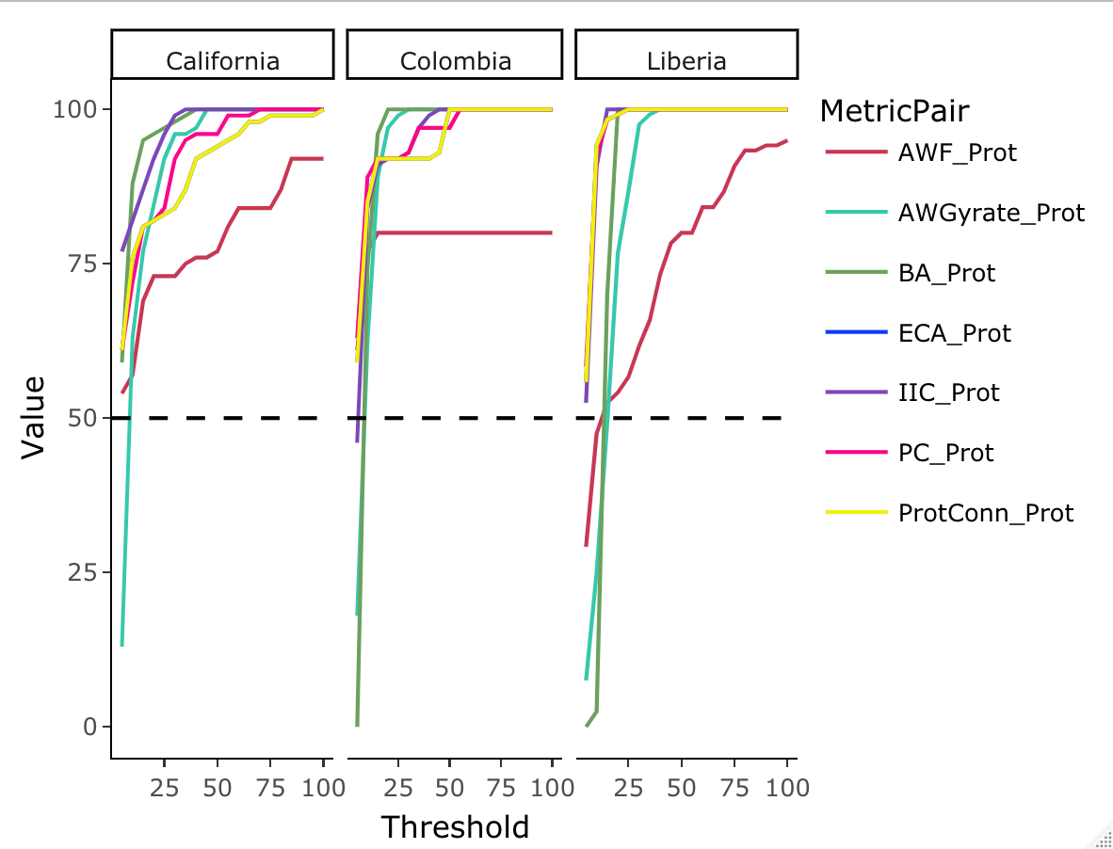
(a)
1. California
2. Colombia
3. Liberia
Metric
AWF
AWGyrate
BA
ECA
IIC
Proportion of simulations (%)
PC
ProtConn
Absolute difference in percent changes with PctArea

Slide 6
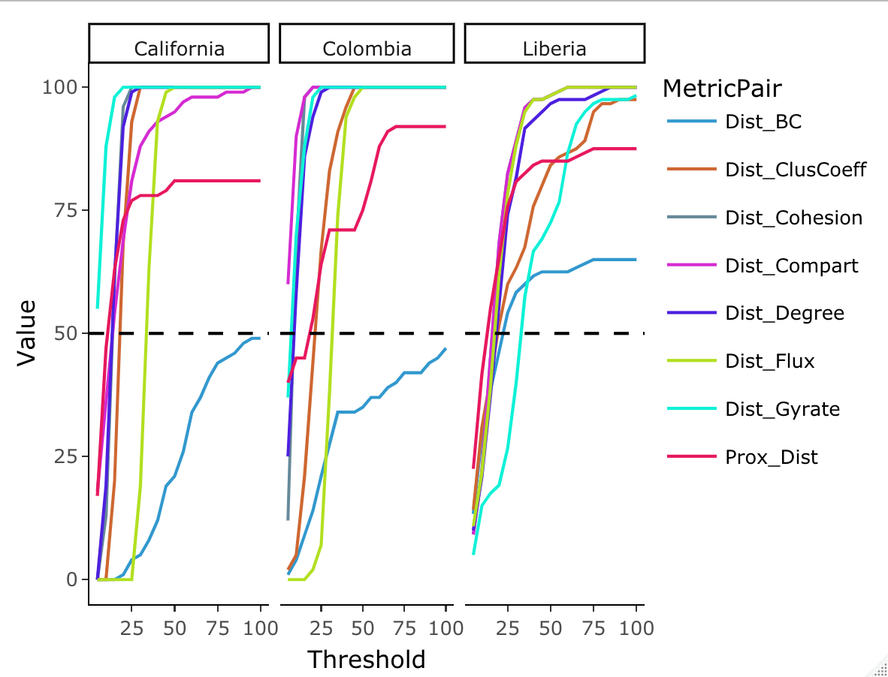
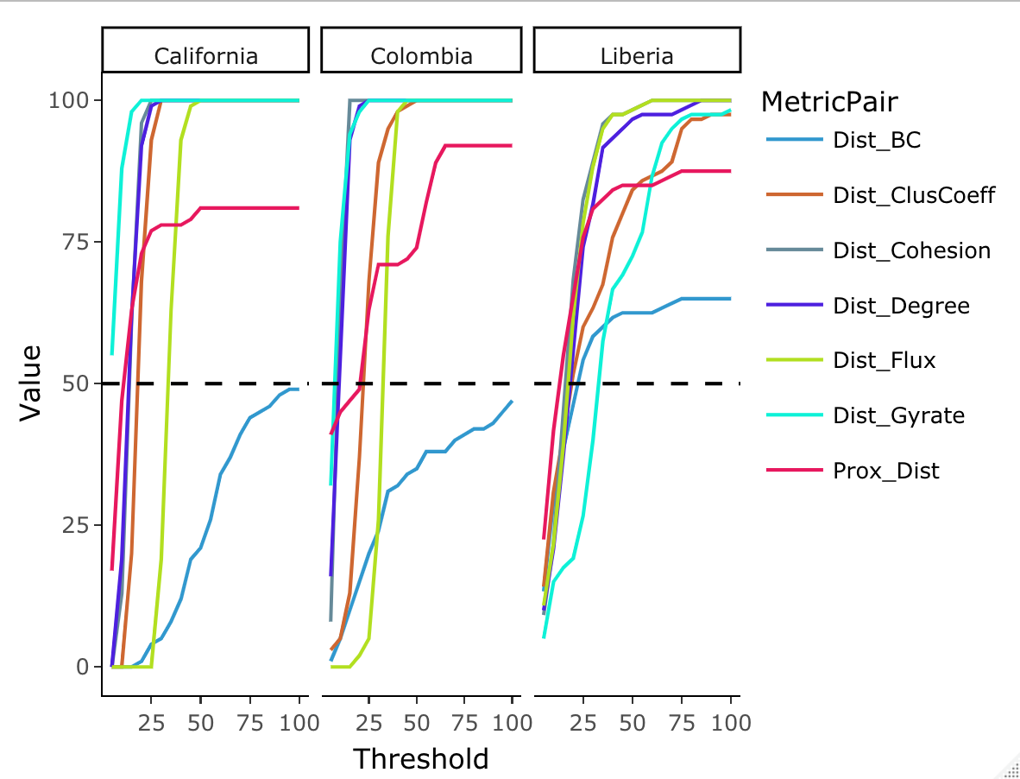
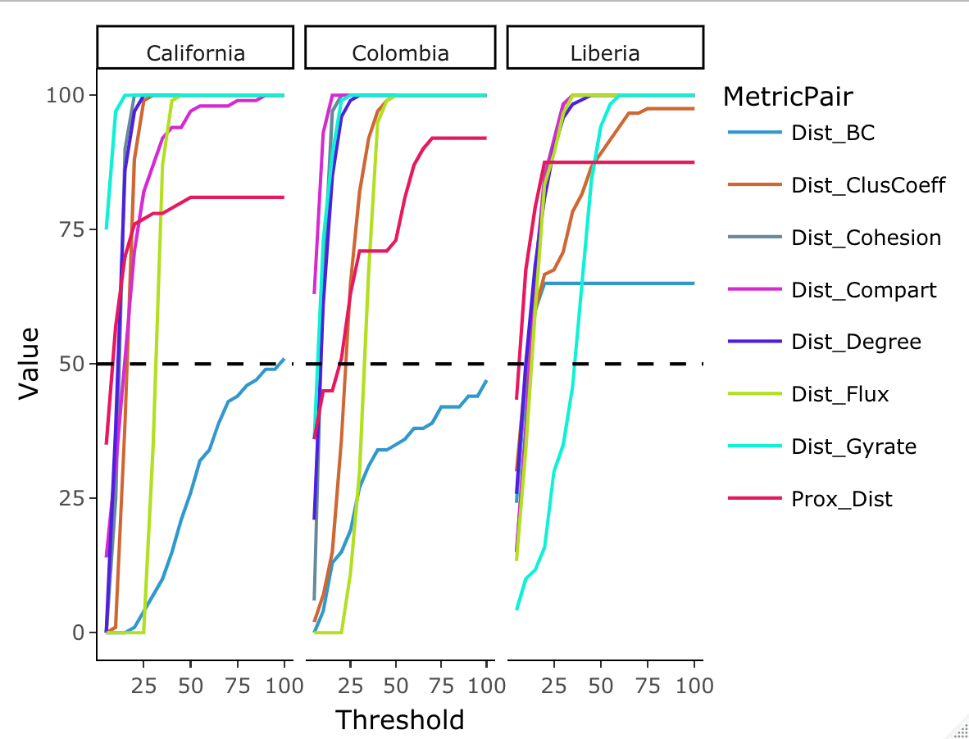
(b)
1. California
2. Colombia
3. Liberia
Metric
BC
ClusCoeff
Cohesion
Compart
Degree
Proportion of simulations (%)
Flux
Gyrate
Prox
Absolute difference in percent changes with Dist

Slide 7
